Slide 1
CS 230 Game Implementation Techniques
Week 9 Lecture
Instructor
Doug Schilling
dschilling@digipen.edu
X5066
Office Hours
Wednesday
1:30pm – 3:00pm
Reflection
Circle-Line Collision

Slide 2
Reflection

Slide 3
Recall: Collision Steps
Check for trivial rejection
Velocity is zero or parallel to line segment
B_{s} and B_{e} either both inside or outside
One-way walls:
Going from inside to outside and the collision type of the line segment is outside, and vice versa.
Calculate the point and time of intersection
Check if the time is between t_{s} and t_{e}, e.g. [0, 1]
Check if the point of intersection is on the line segment

Slide 4
Recall: Collision Scenario
Given:
Static wall of finite length and infinitesimal thickness
Dynamic ball with an infinitesimal radius
Problem:
Ensure dynamic ball correctly collides and bounces off wall

Slide 5
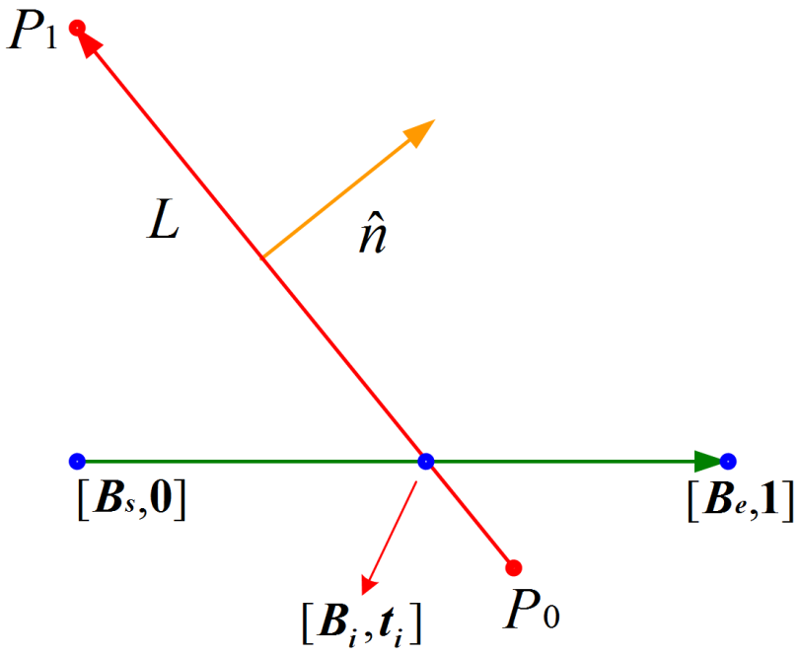
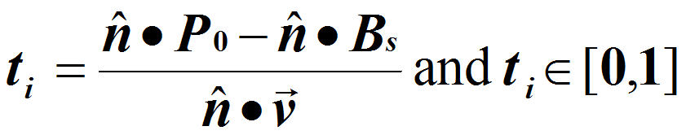
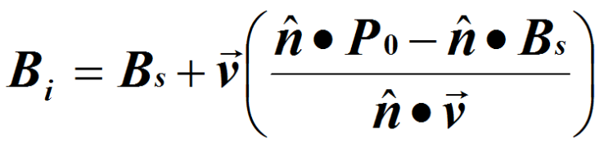

Recall: Point-Line Intersection
Ball modeled as an infinitesimal point
$B\left(t\right)=B_{s}+\vec{v}t∈\left[0,1\right]$
Wall modeled as:
$L:\hat{n}∙P−\hat{n}∙P_{0}=0$

Slide 6
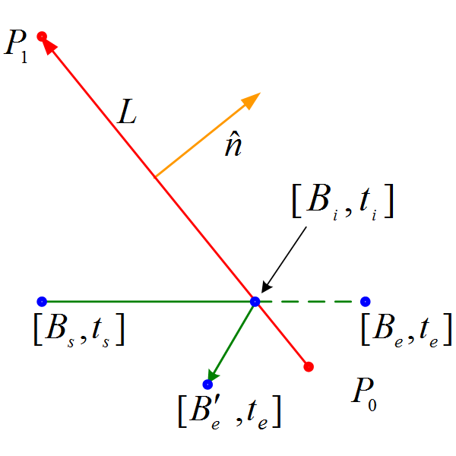
Position of Ball After Collision
Assuming elastic collision

Slide 7
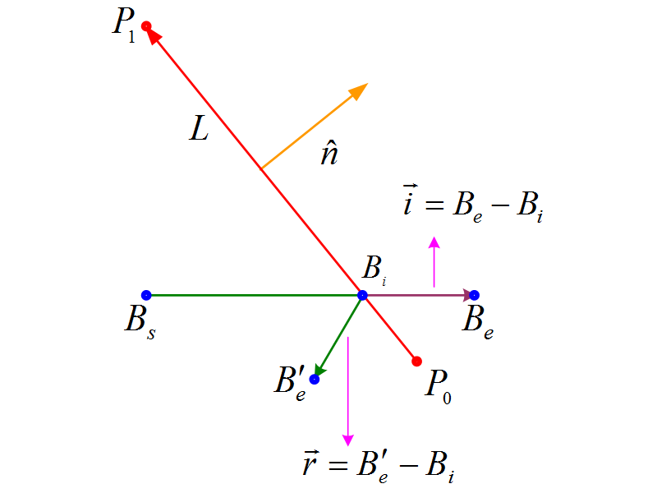

Position of Ball After Collision
Assuming elastic collision
Initial path
$\vec{i}=B_{e}−B_{i}$
Reflected path
$\vec{r}=B_{e}^{′}−B_{i}$

Slide 8
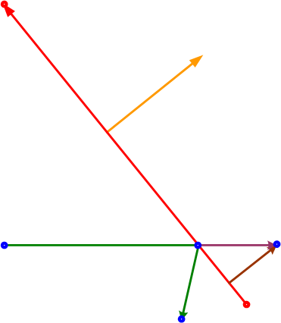

Position of Ball After Collision
Assuming elastic collision
Initial path
$\vec{i}=B_{e}−B_{i}$
Reflected path
$\vec{r}=B_{e}^{′}−B_{i}$
Penetration vector
$\vec{s}=\left(\vec{i}∙\hat{n}\right)\hat{n}$
Min. translation distance

Slide 9
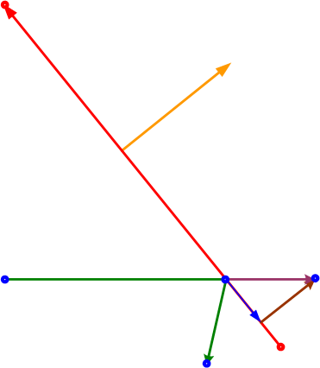

Position of Ball After Collision
Assuming elastic collision
Initial path
$\vec{i}=B_{e}−B_{i}$
Reflected path
$\vec{r}=B_{e}^{′}−B_{i}$
Penetration vector
$\vec{s}=\left(\vec{i}∙\hat{n}\right)\hat{n}$
Min. translation distance
Lateral vector
$\vec{m}=\vec{i}−\vec{s}$

Slide 10
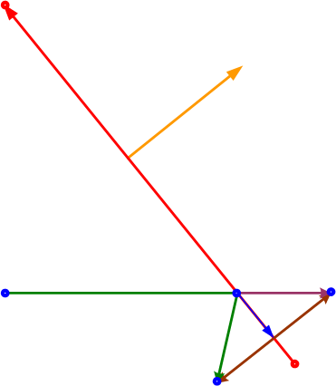

Position of Ball After Collision
Solving Reflection:
Reflected path
$\vec{r}=B_{e}^{′}−B_{i}$
Reflection vector
$\vec{r}=\vec{m}−\vec{s}$
$\vec{r}=\left(\vec{i}−\vec{s}\right)−\vec{s}$
$\vec{r}=\vec{i}−2\vec{s}$
$\vec{r}=\vec{i}−2\left(\vec{i}∙\hat{n}\right)\hat{n}$
End point
$B_{e}^{′}=B_{i}+\vec{r}$
$B_{e}^{′}=B_{i}+\vec{i}−2\left(\vec{i}∙\hat{n}\right)\hat{n}$

Slide 11

Position of Ball After Collision
Solving Reflection:
Reflection vector
$\vec{r}=B_{e}^{′}−B_{i}$
$\vec{r}=\vec{m}−\vec{s}$
$\vec{r}=\left(\vec{i}−\vec{s}\right)−\vec{s}=\vec{i}−2\vec{s}$
$\vec{r}=\vec{i}−2\left(\vec{i}∙\hat{n}\right)\hat{n}$
End point?
$B_{e}^{′}=B_{i}+\vec{r}$
$B_{e}^{′}=B_{i}+\vec{i}−2\left(\vec{i}∙\hat{n}\right)\hat{n}$
New velocity direction?
$\hat{v}=\frac{\vec{r}}{\left\|\vec{r}\right\|}$

Slide 12
Questions?

Slide 13
Circle-Line Collision

Slide 14
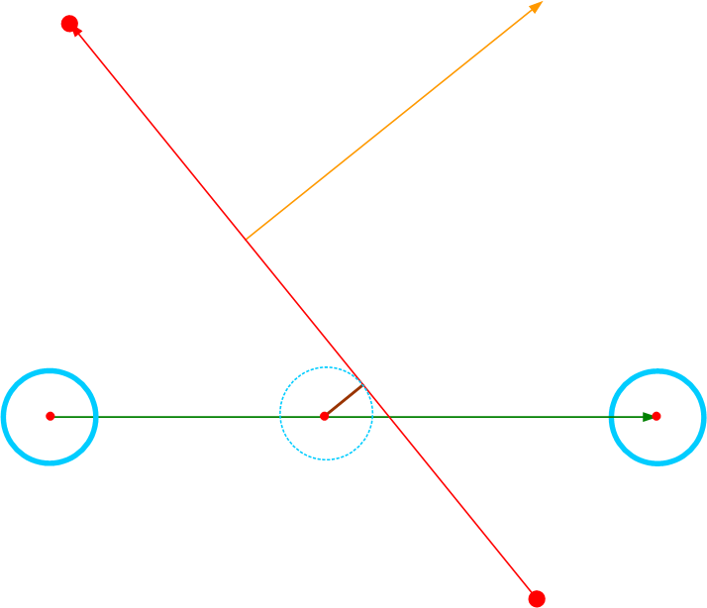
New Collision Scenario
Given:
Static wall of finite length and infinitesimal thickness
Dynamic ball modeled by a circle with radius r
Problem:
Ensure dynamic ball correctly collides and bounces off wall

Slide 15
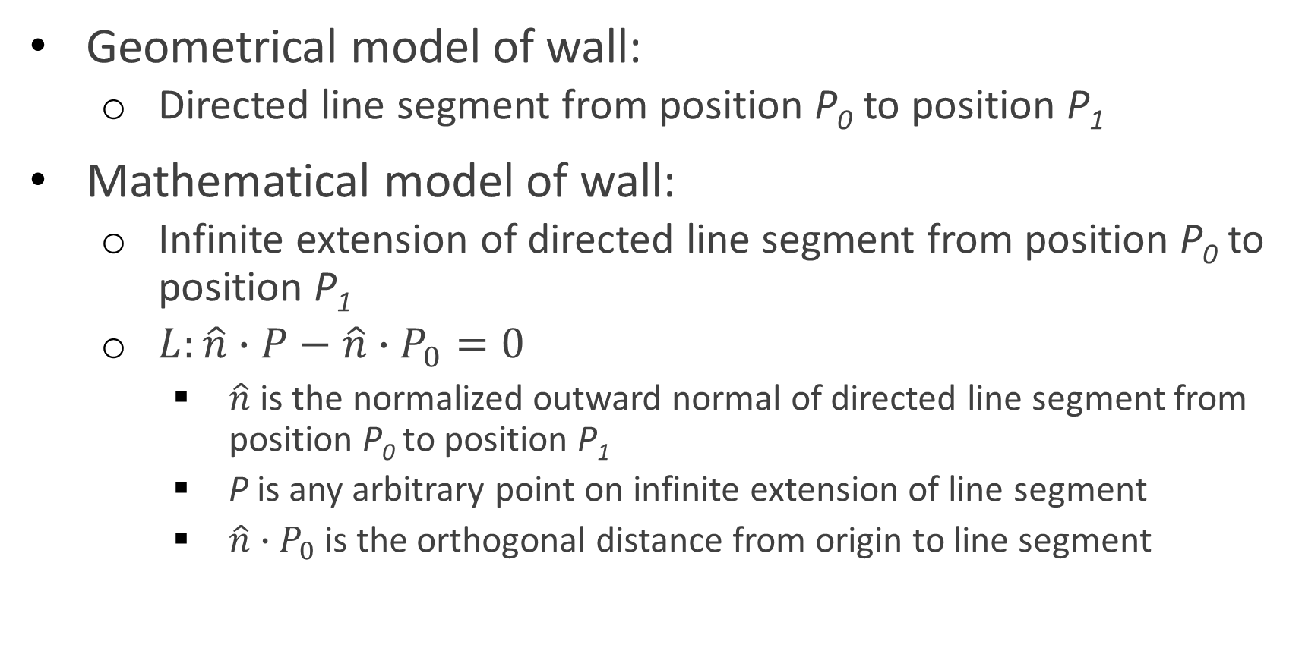
Modeling a Wall
Geometrical model of wall:
Directed line segment from position P₀ to position P₁
Mathematical model of wall:
Infinite extension of directed line segment from position P₀ to position P₁
$L:\hat{n}∙P−\hat{n}∙P_{0}=0$
$\hat{n}$ is the normalized outward normal of directed line segment from position P₀ to position P₁
P is any arbitrary point on infinite extension of line segment
$\hat{n}∙P_{0}$is the orthogonal distance from origin to line segment

Slide 16
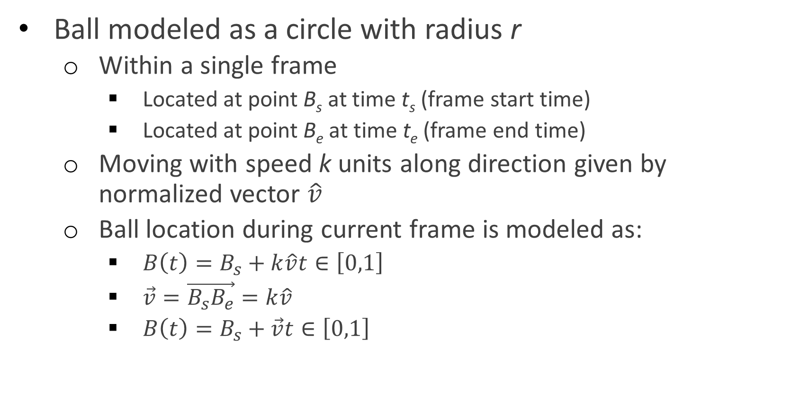
Modeling a Ball
Ball modeled as a circle with radius r
Within a single frame
Located at point B_{s} at time t_{s} (frame start time)
Located at point B_{e} at time t_{e} (frame end time)
Moving with speed k units along direction given by normalized vector $\hat{v}$
Ball location during current frame is modeled as:
$B\left(t\right)=B_{s}+k\hat{v}t∈\left[0,1\right]$
$\vec{v}=\vec{B_{s}B_{e}}=k\hat{v}$
$B\left(t\right)=B_{s}+\vec{v}t∈\left[0,1\right]$

Slide 17
Circle-Line Intersection
How to check for collision?

Slide 18
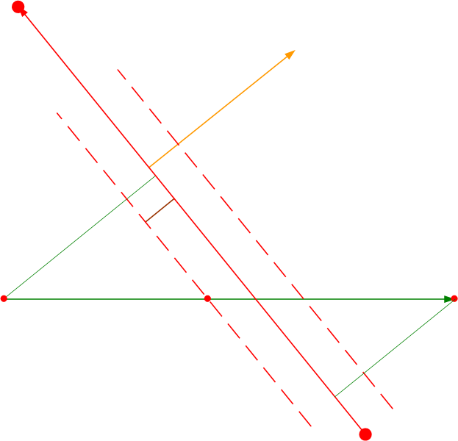

Circle-Line Intersection
Ball modeled as an infinitesimal point
$B\left(t\right)=B_{s}+\vec{v}t∈\left[0,1\right]$
Line modeled as:
$L:\hat{n}∙P−\hat{n}∙P_{0}=D$
So, what is D?
Depends on position of B_{s}

Slide 19

Circle-Line Intersection
If B_{s} is inside,
$L:\hat{n}∙P−\hat{n}∙P_{0}=−r$
If B_{s} is outside,
$L:\hat{n}∙P−\hat{n}∙P_{0}=r$

Slide 20

Circle-Line Intersection
Ball modeled as an infinitesimal point
$B\left(t\right)=B_{s}+\vec{v}t∈\left[0,1\right]$
Wall modeled as:
$L:\hat{n}∙P−\hat{n}∙P_{0}=D$
D = -r (inside), D = r (outside)
Time of intersection:
$t_{i}=\frac{\hat{n}∙P_{0}−\hat{n}∙B_{s}+D}{\hat{n}∙\vec{v}}, t_{i}∈\left[0,1\right]$
$\text{Point} \text{of} \text{intersection}\text{:}$
$B_{i}=B_{s}+\vec{v}t_{i}$

Slide 21
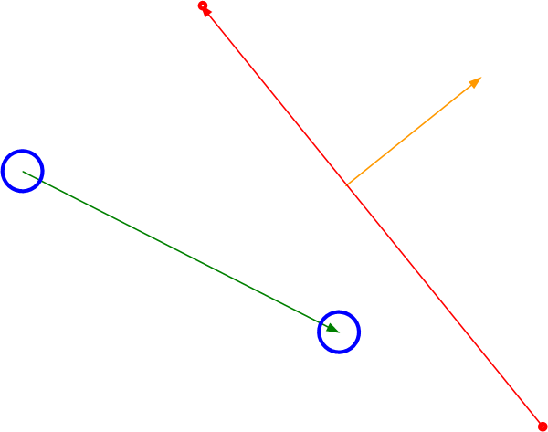
Test for Non-Collision
Ball remains within inside half-plane
$$\left(\hat{n}∙B_{s}−\hat{n}∙P_{0}<−r\right) \&\& \left(\hat{n}∙B_{e}−\hat{n}∙P_{0}<−r\right)$$

Slide 22
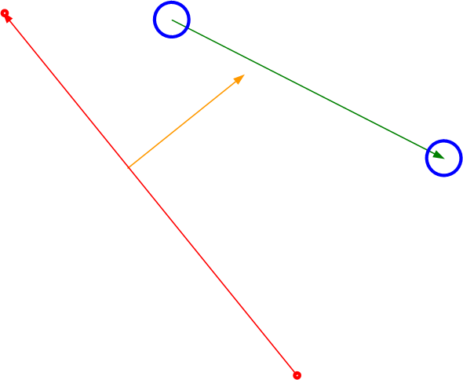
Test for Non-Collision
Ball remains within outside half-plane
$$\left(\hat{n}∙B_{s}−\hat{n}∙P_{0}>r\right) \&\& \left(\hat{n}∙B_{e}−\hat{n}∙P_{0}>r\right)$$

Slide 23
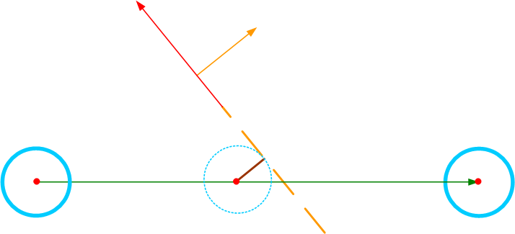

Test for Non-Collision
Ball collides with infinite extension of wall “before” P₀
$$\left(B_{i}−P_{0}\right)∙\left(P_{1}−P_{0}\right)<0$$

Slide 24
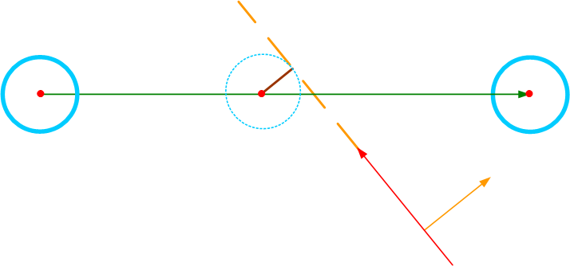

Test for Non-Collision
Ball collides with infinite extension of wall “beyond” P₁
$$\left(B_{i}−P_{1}\right)∙\left(P_{0}−P_{1}\right)<0$$

Slide 25
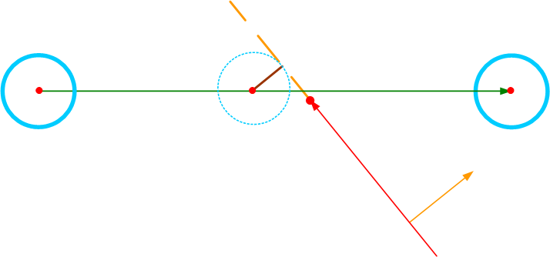
Wait! There’s a Problem!
The intersection point B_{i} is not on the line, but the ball collides with the wall
Solution?
Hint:

Slide 26
Questions?

